Slide 1
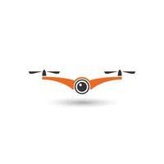
1 Axis PID Drone Controller By
M Abdullah Sohail (343642)
Wajih Hassan Raza (356850)
Muhammad Ibrahim (337300)
Mirza Wasay Baig (343690)
Muhammad Moiz (331847)
Submitted to: Sir Yasir Rizwan
Instructor: Dr Farid Gul

Slide 2

Problem Satement
Problems?
Conventional systems with unresponsive maneuverability
Poor stability
External disturbances
Solution
Design an effective control system
Regulating Motor speed
Compensate for Disturbances

Slide 3
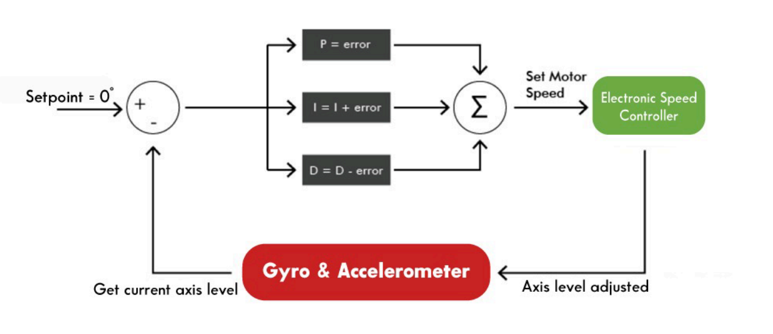
The PID Algorithm

Slide 4
Steps for Theoretical Analysis
Determine the transfer function of the plant (BLDC)
Model the transfer function in control system designer
Specify the design requirements
Acquire the coefficients of the PID Controller

Slide 5
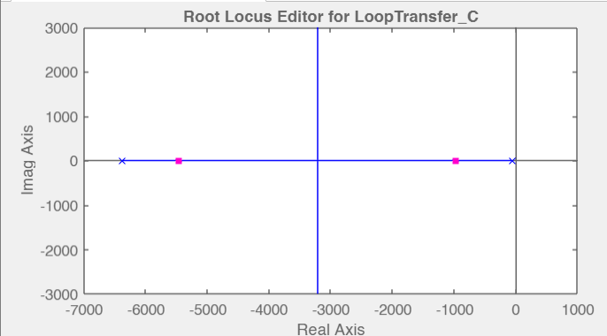
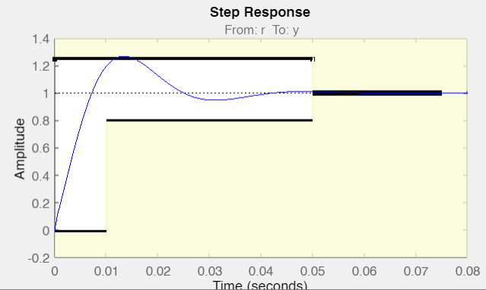
Unity Feedback Response Without Controller
Root Locus
Step Response
% OS < 25% Ts < 0.05s

Slide 6
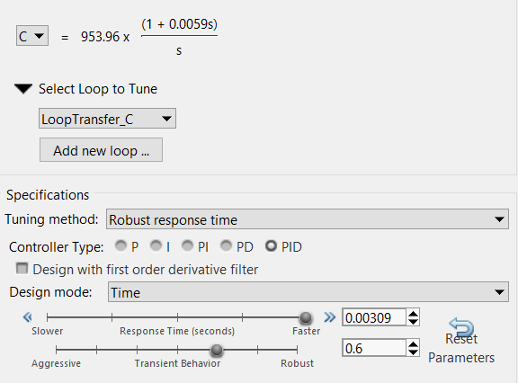
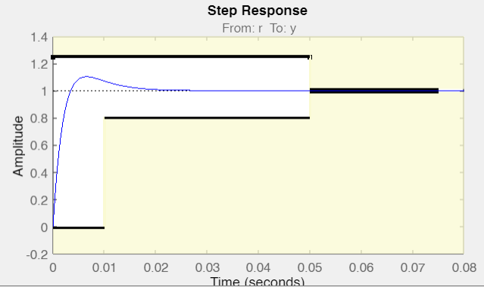
PID Controller
Design Requirements
Updated Step Response

Slide 7
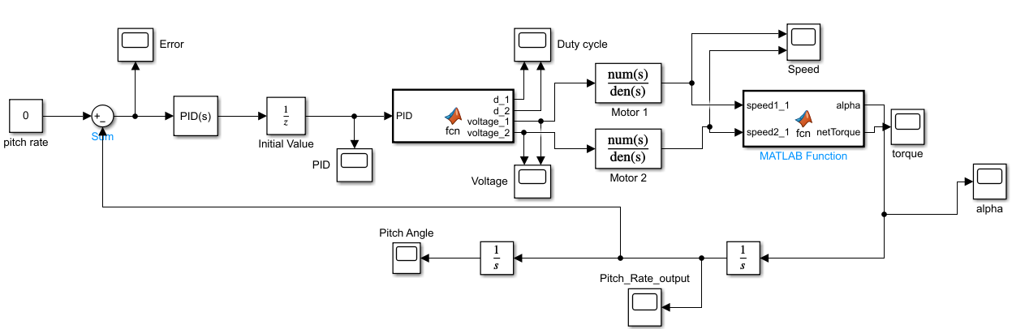
Simulink Model

Slide 8
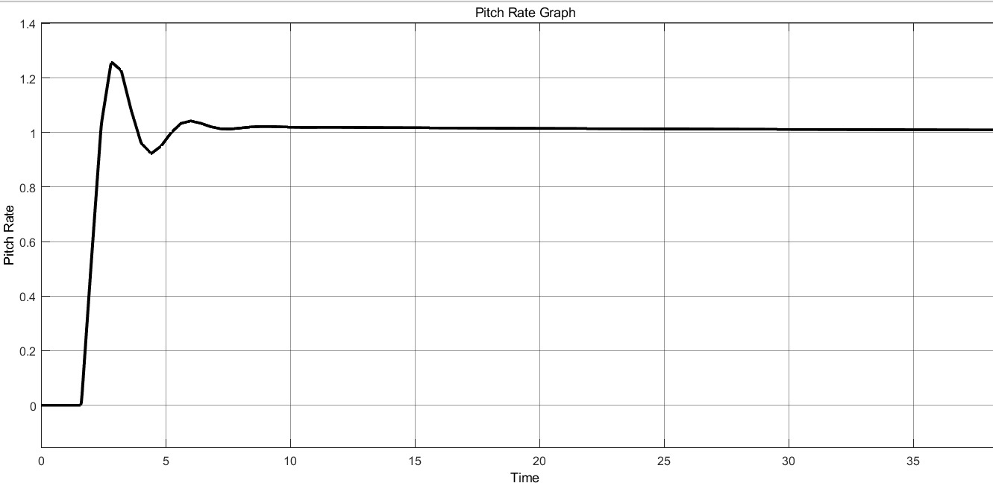
Output Graphs
Step Response
Percent OS = 24.7 %
Steady State Error = 0.02
ζ = 0.88
ω = 2.32
Tp = 2.840 s
Ts = 9.5 s

Slide 9
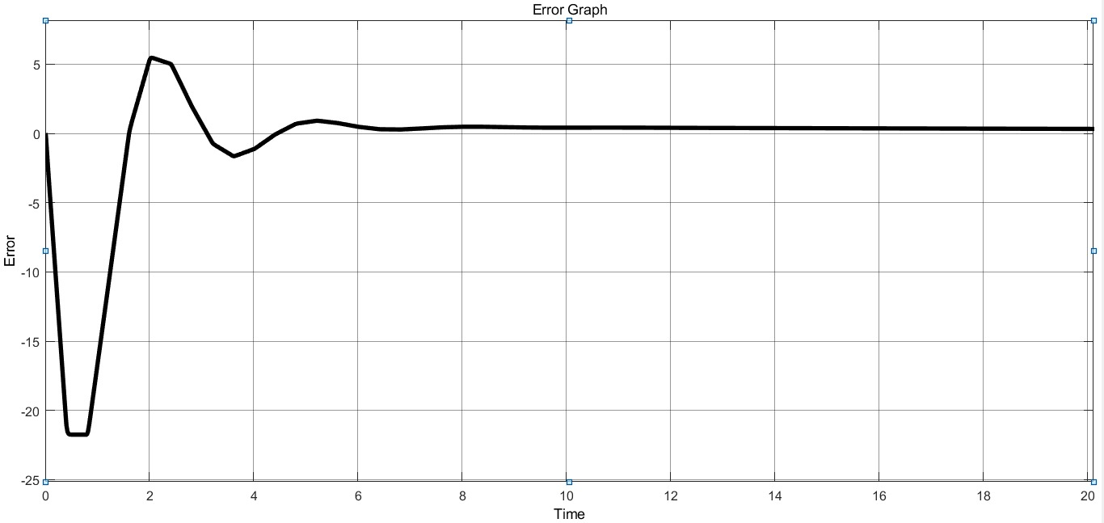
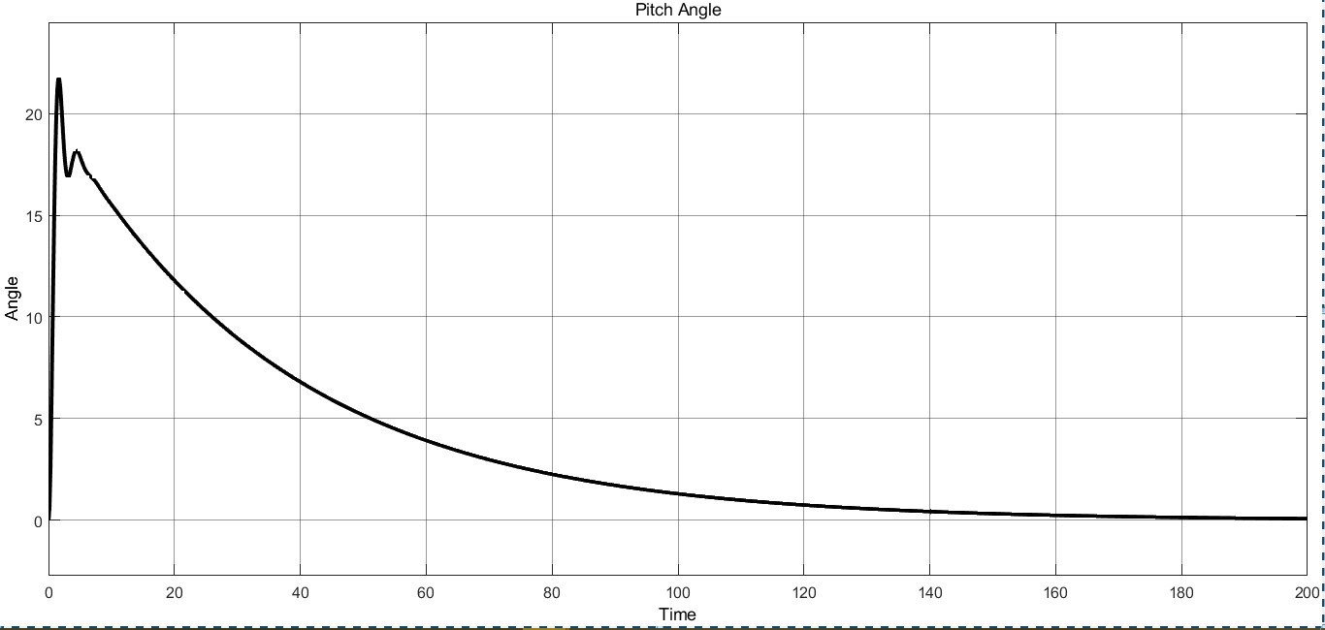
Continued…
Error Plot
Pitch Angle

Slide 10
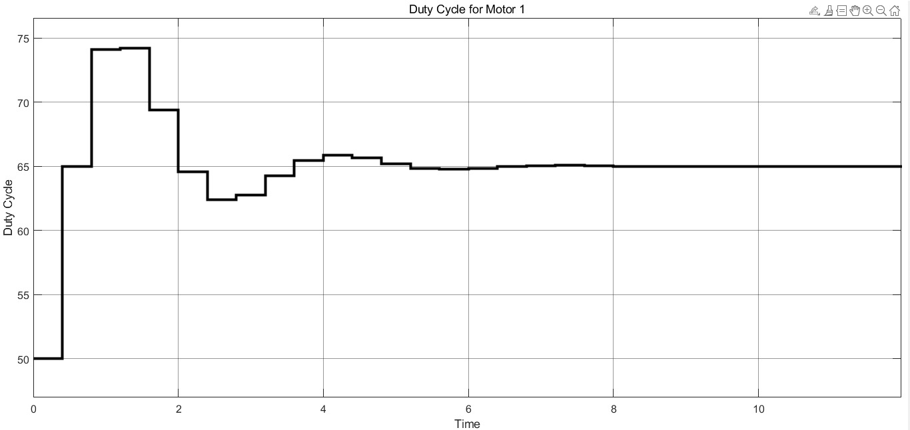
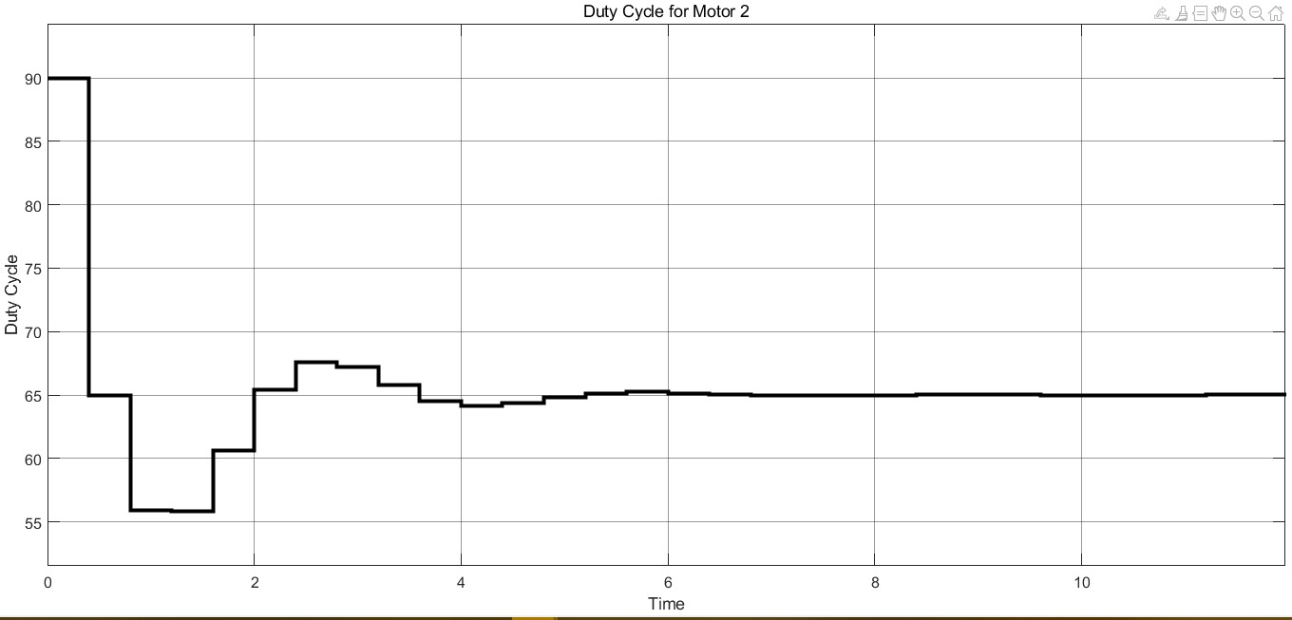
Continued…
Duty Cycle M1
Duty Cycle M2

Slide 11
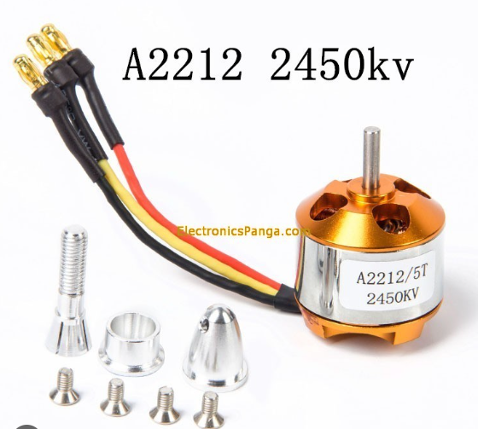
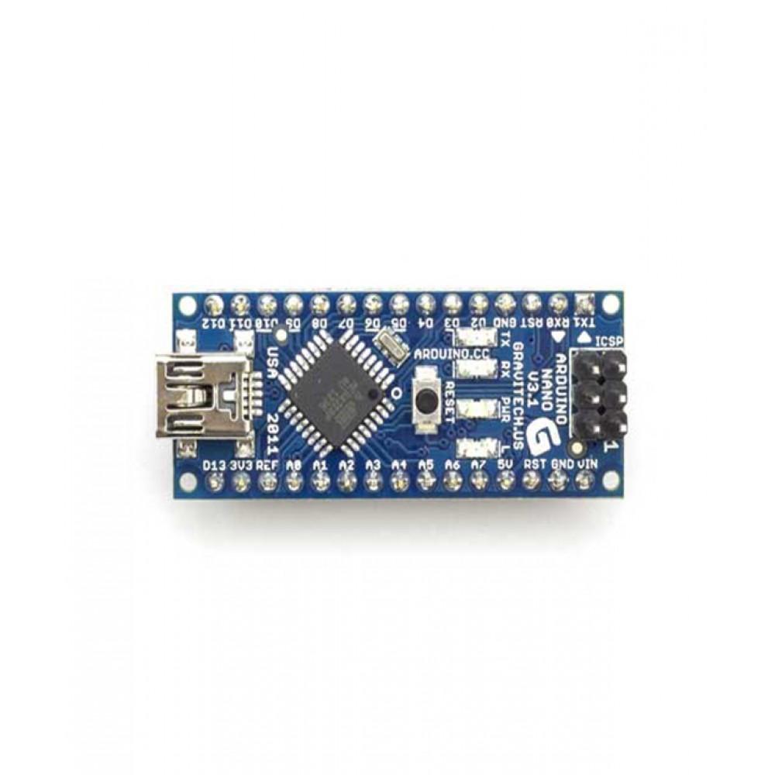
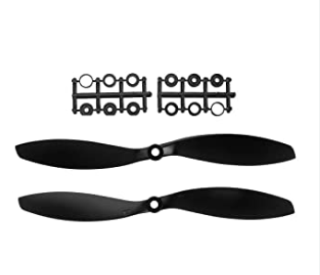
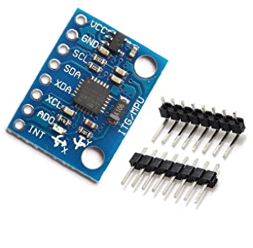
Hardware Components
Arduino Nano(+Gyroscope Module)
Motors and Propellers

Slide 12
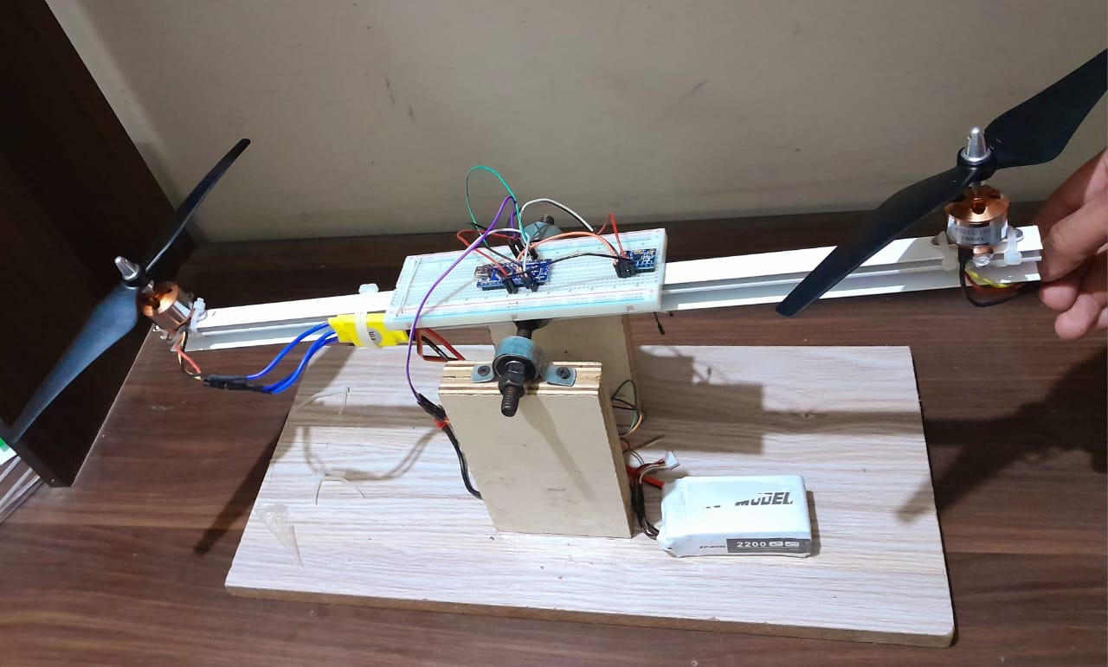
Our Prototype

Slide 13
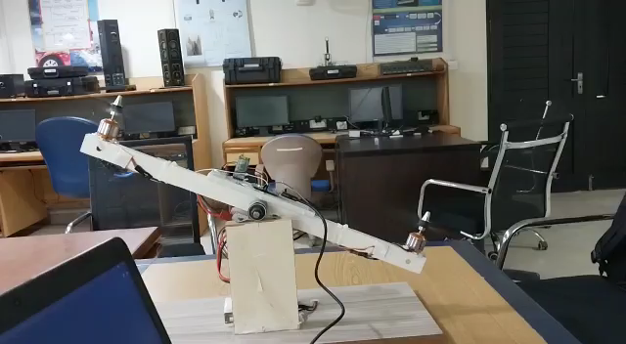
Demo Video

Slide 14
Challenges Faced
Deciding the variable of Analysis
PID Tuning
Selecting the choice of Motors and Threshold Speed.
Different PID coefficients for hardware.

Slide 15
Current Research
Multi-axis Controller
Integration with other control techniques
Integration of Deep Learning

Slide 16

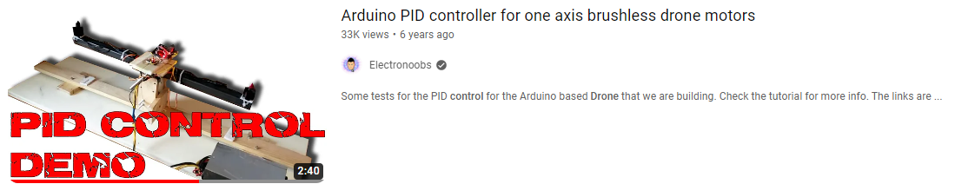
References
[“PID Control with Arduino," Electronoobs, 2017. [Online]. Available: http://electronoobs.com/eng_robotica_tut6_1.php
Electronoobs, “Arduino PID controller for one axis brushless drone motors," 2017. [Online]. Available: https://www.youtube.com/watch?v=w2hZoZQyRw8&t=96s
PID Control of Brushless DC Motor: https://www.theseus.fi/bitstream/handle/10024/494317/BLDC_Motor_PID_Controller.pdf?sequence=2&isAllowed=y

